Slide 1


Smart Tourism (Dalilak System)
Department of Computer Science Collage Computer and Information Technology
Alamri. A 43802174 Alghamdi. A 43806050 Alharthi. B 43801497 Almalki. B 43812868 Ayoub. O 43808549 Alshehri. W 43805484
Advisor: Dr. Fahad Alharthi

Slide 2
Introduction

Slide 3
Topics
Review System Idea
Database implementation
Rest API
Machine Learning
Application (Xamarin cross-platform)
ASP.Net Website
Test and evaluation

Slide 4

Review General Idea
The system will be a smartphone application, focus on guide people, manage their trips, give information, locate events, natural places, and historical places
Develop automated scheduling that depends on users’ requirements that are processed and analyzed by applying Artificial Intelligence and Data analysis algorithms
Designing an interface to let the user schedule and manage the trip manually that makes the user have unlimited choices.
To give an information about natural and historical places, that make tourists browse the app and have an insight background about their destination.
To develop a method to give an ability for guiders to add new natural places into the system dynamically as advice for tourists.
Design a dashboard to manage the system by the stockholder (Administrator).

Slide 5
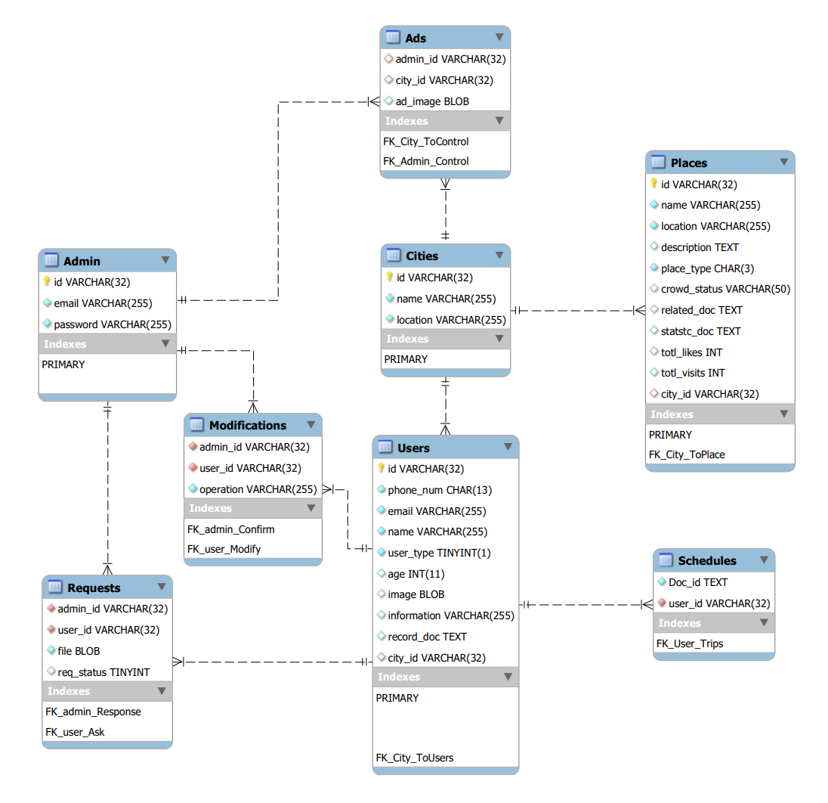
MySQL Diagram

Slide 6
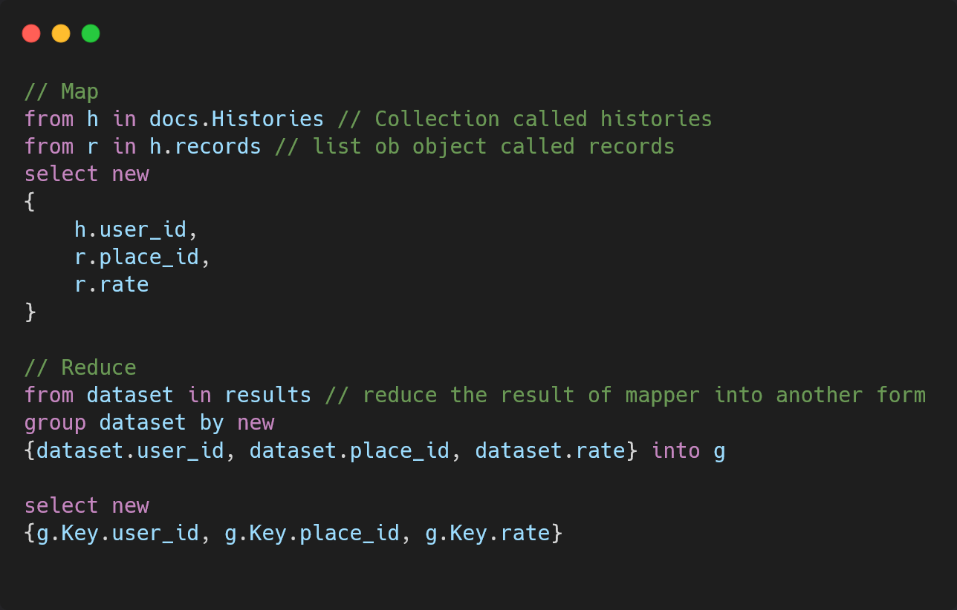
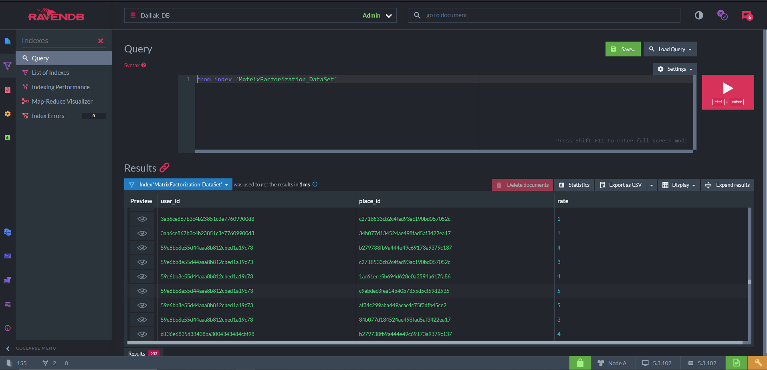
RavenDB MapReduce
RavenDB framework - Map reduce
RavenDB platform - Map reduce Result

Slide 7
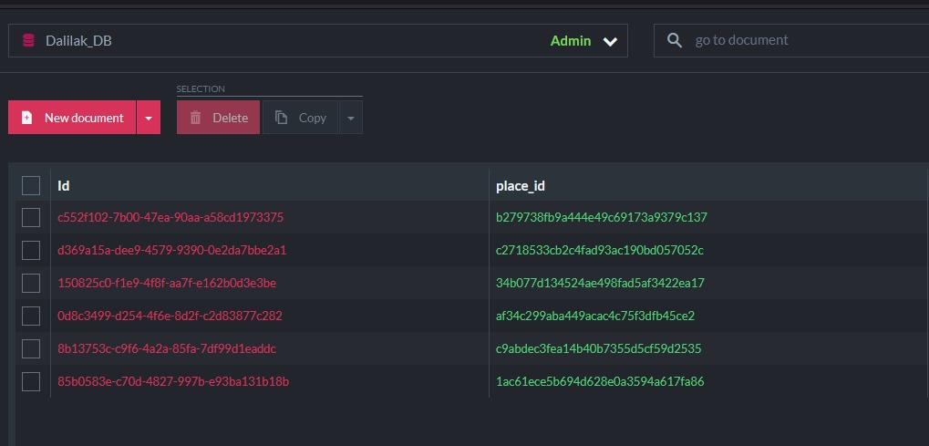
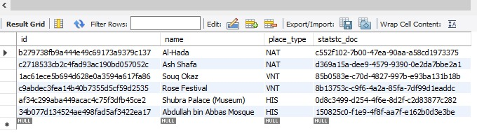
Database Records

Slide 8
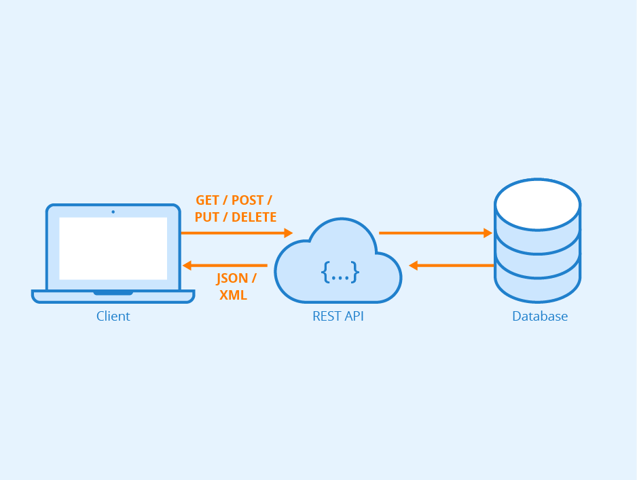
Rest API

Slide 9
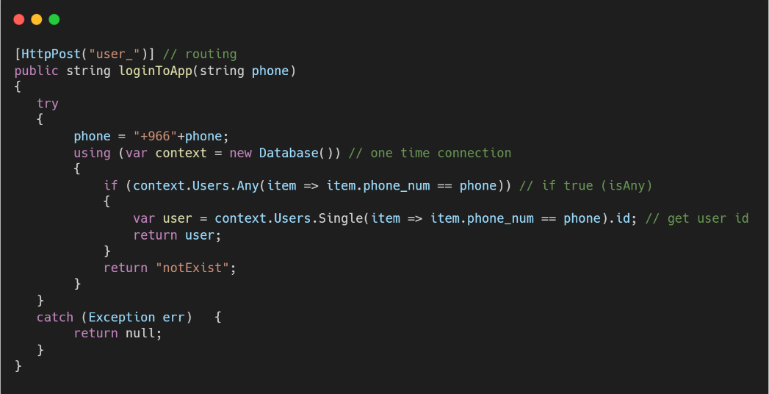
API Requests

Slide 10
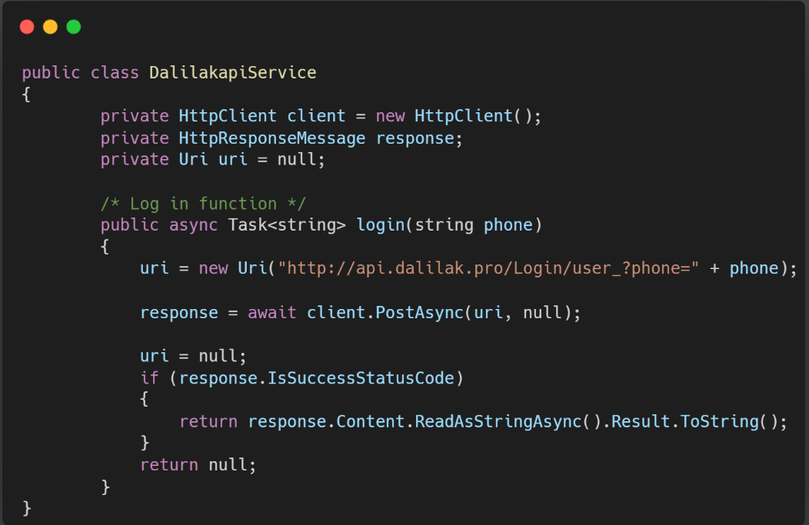
API Response

Slide 11
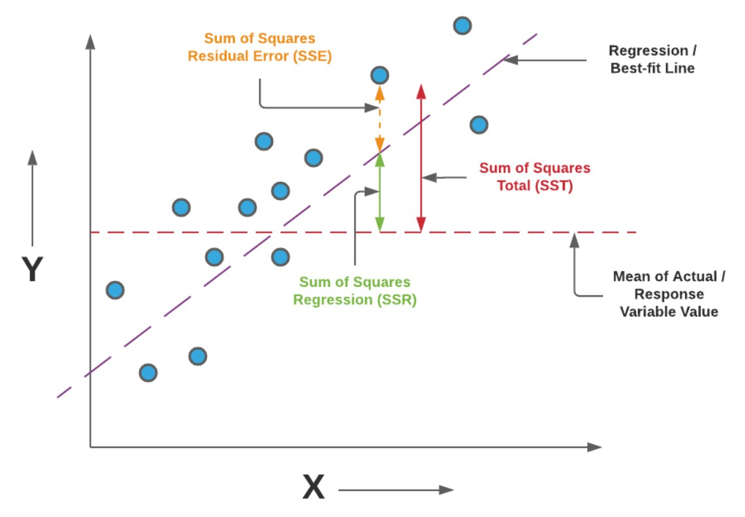

Machine Learning (prepare data and accuracy measurements)
Normalize Binning
One-Hot Encoding
$R^{2}=\frac{variance\left(mean\right)−variance(line)}{variance(mean)}$
$RMSE= \sqrt{\sum_{i}^{n}{{({predicted}_{i} −{actual}_{i})}^{2}}}$
Time, visits_ Rate, ... date_Wednesday – November, date_Wednesday - September
0 12 0.348131 ... 1 0
1 16 0.612150 ... 0 0
2 21 0.168224 ... 0 0
3 19 0.577103 ... 0 1
4 0 0.119159 ... 0 0
.. ... ... ... ... ...
876 21 0.170561 ... 0 1
877 4 0.093458 ... 0 0
878 0 0.165888 ... 1 0
879 12 0.161215 ... 1 0
880 7 0.186916 ... 0 0

Slide 12
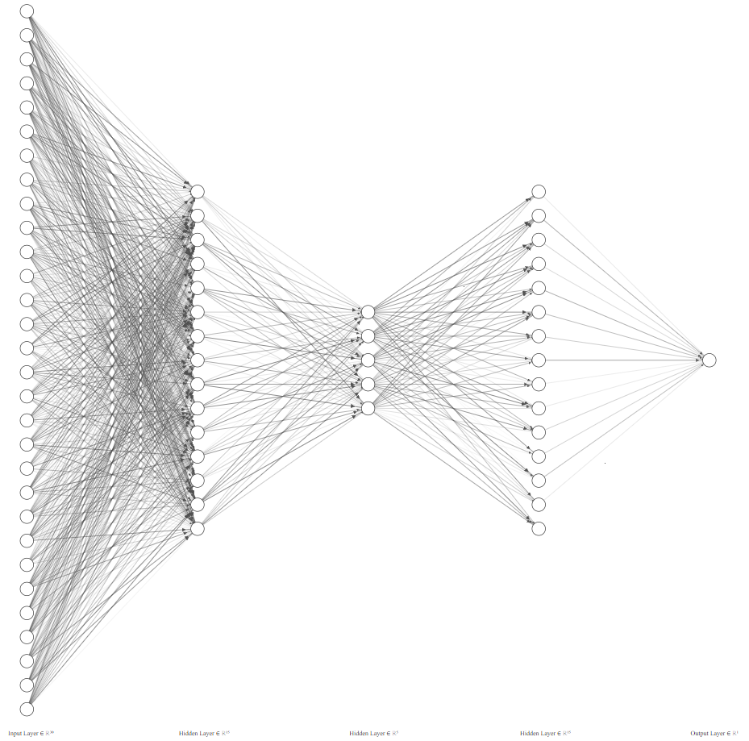
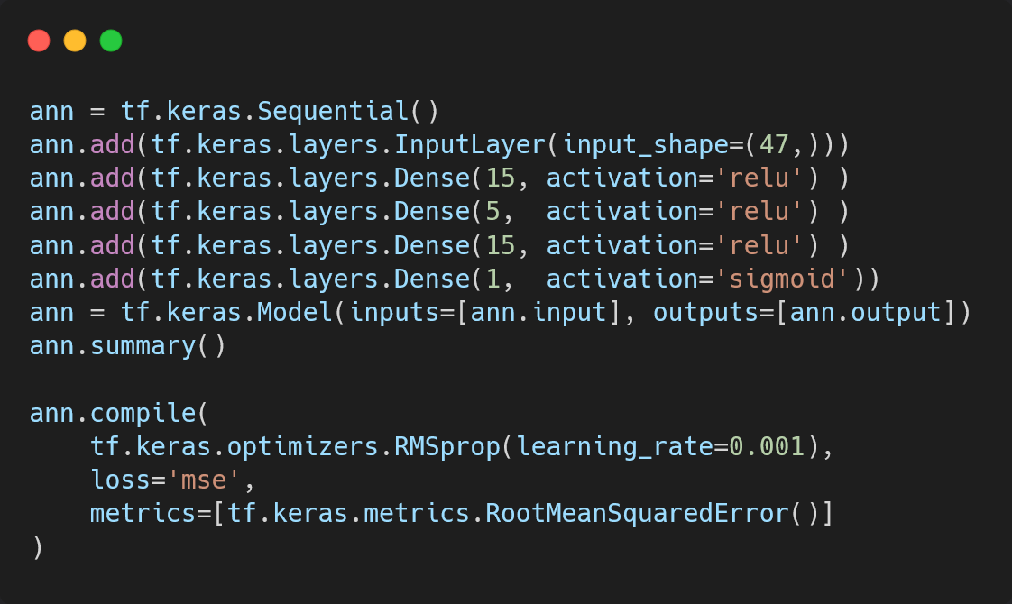
Neural Network

Slide 13
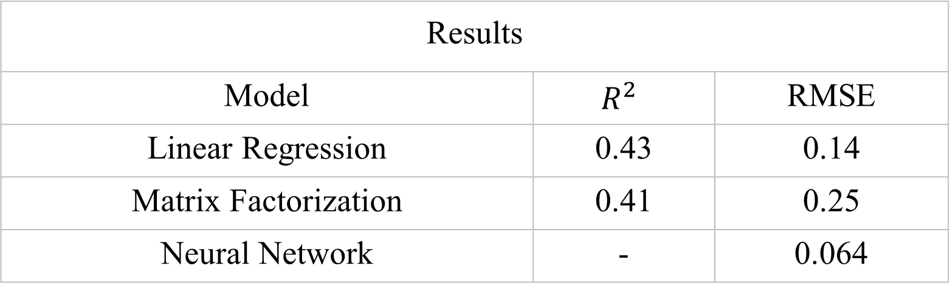
Machine Learning Results
Results
Model | $$R^{2}$$ | RMSE
Linear Regression | 0.43 | 0.14
Matrix Factorization | 0.41 | 0.25
Neural Network | - | 0.064
Notes:
Regression is method dealing with linear dependencies, neural networks can deal with nonlinearities. So if your data will have some nonlinear dependencies, neural networks should perform better than regression.

Slide 14

Application (Xamarin-Cross Platform)

Slide 15
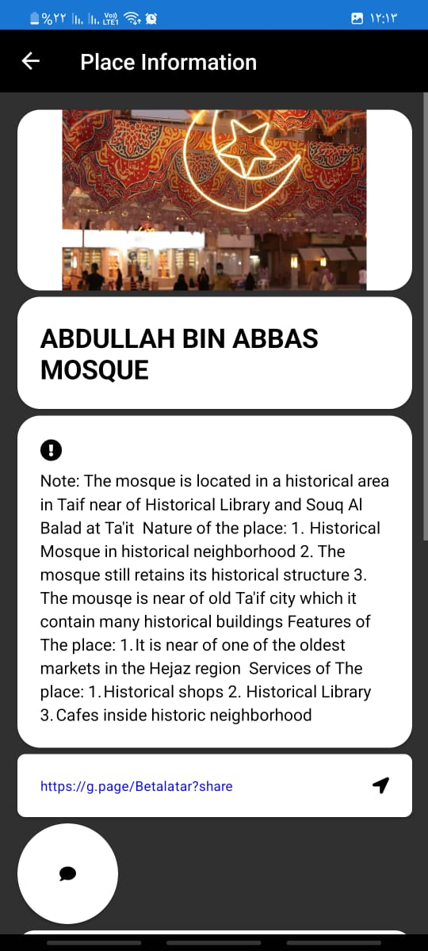
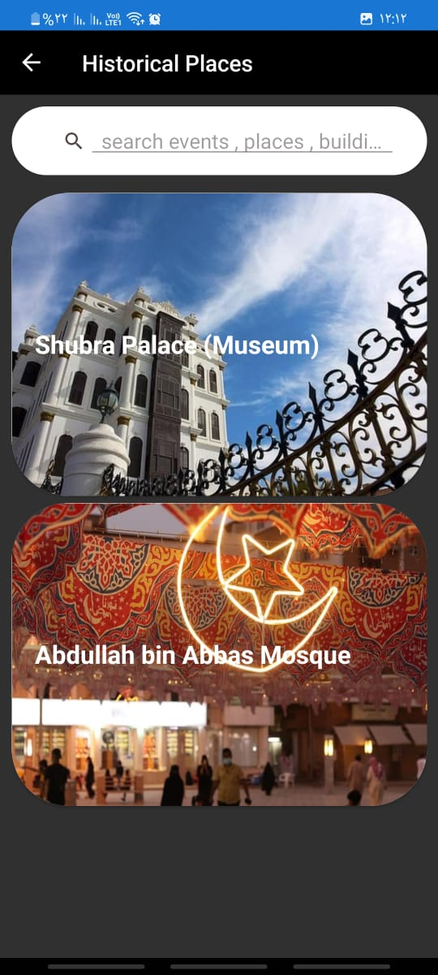
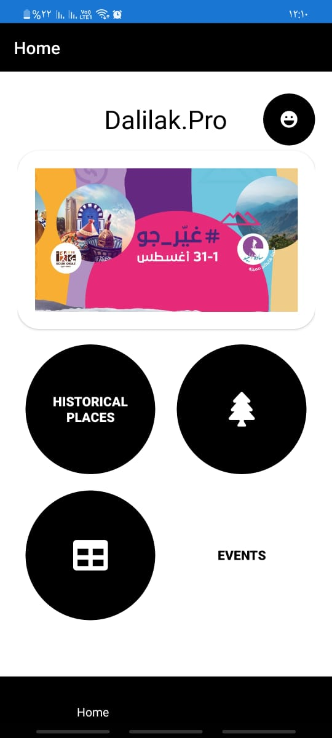
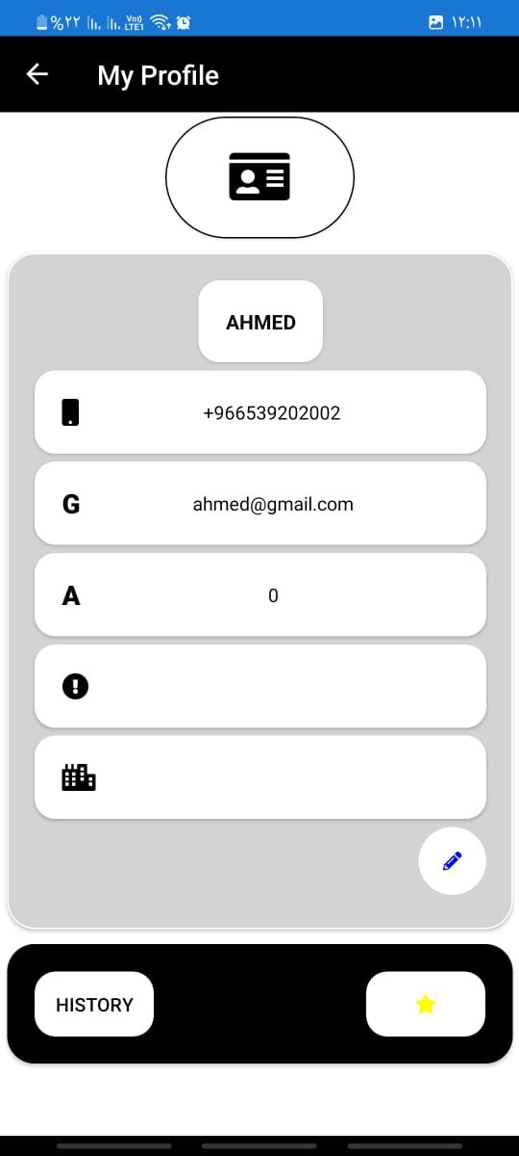
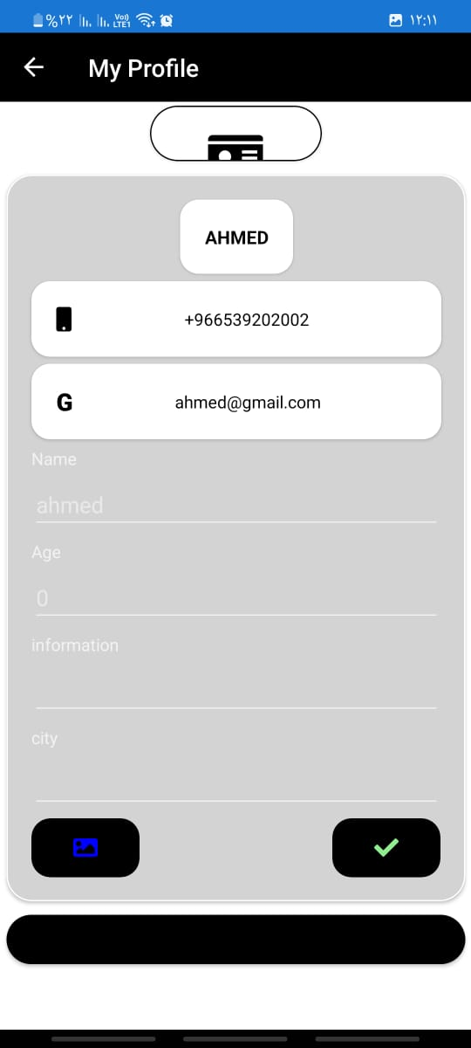
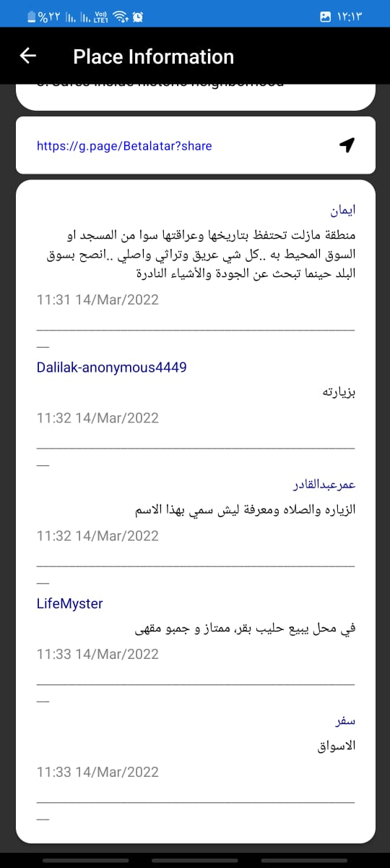
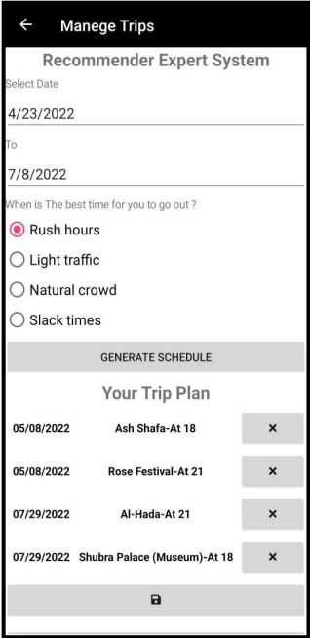
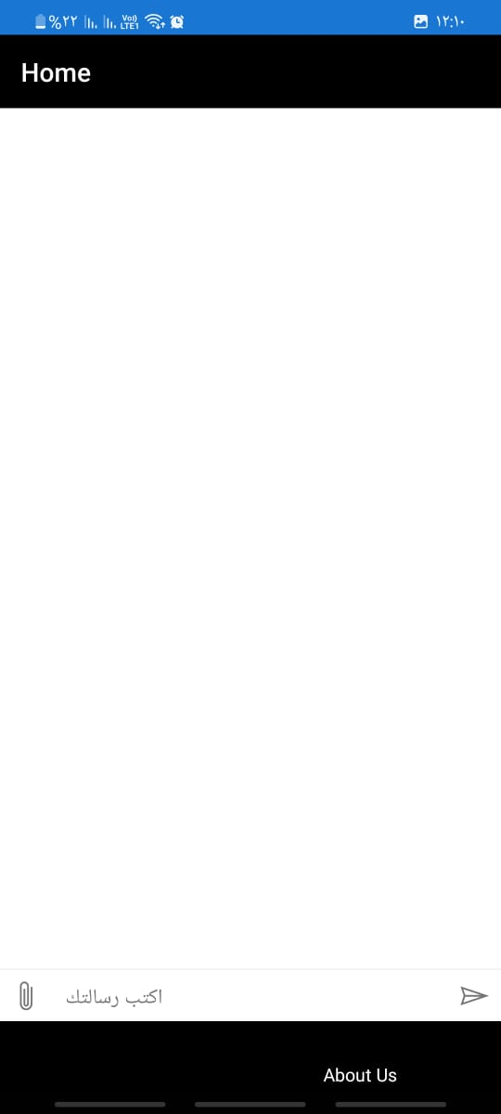
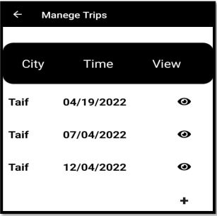
App – GUI

Slide 16
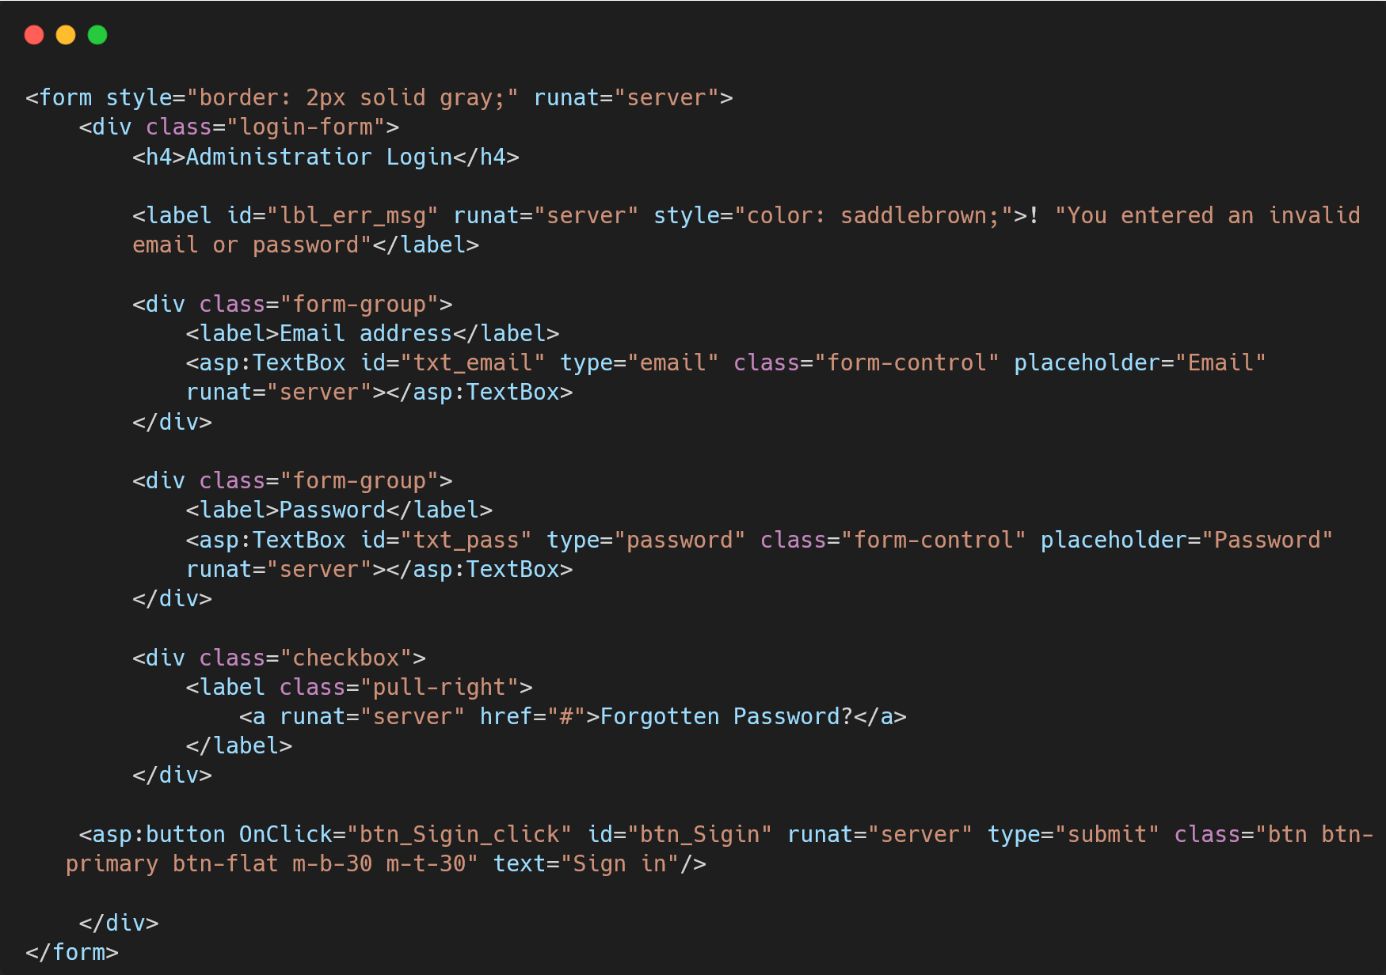
ASP.Net Web forms

Slide 17
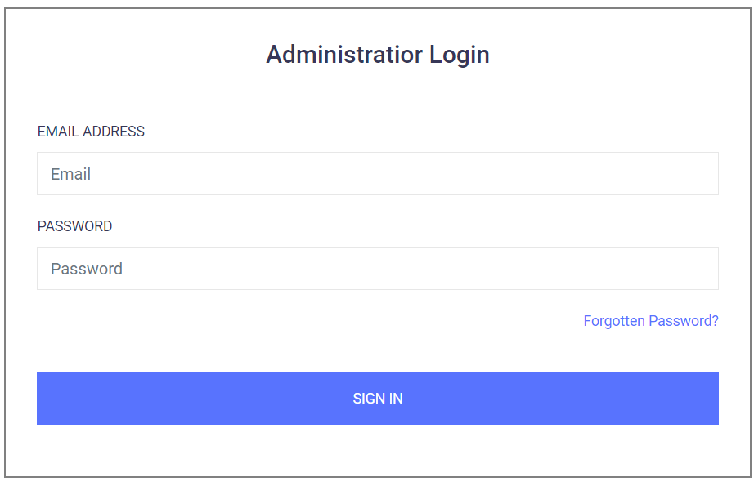
Website - GUI

Slide 18
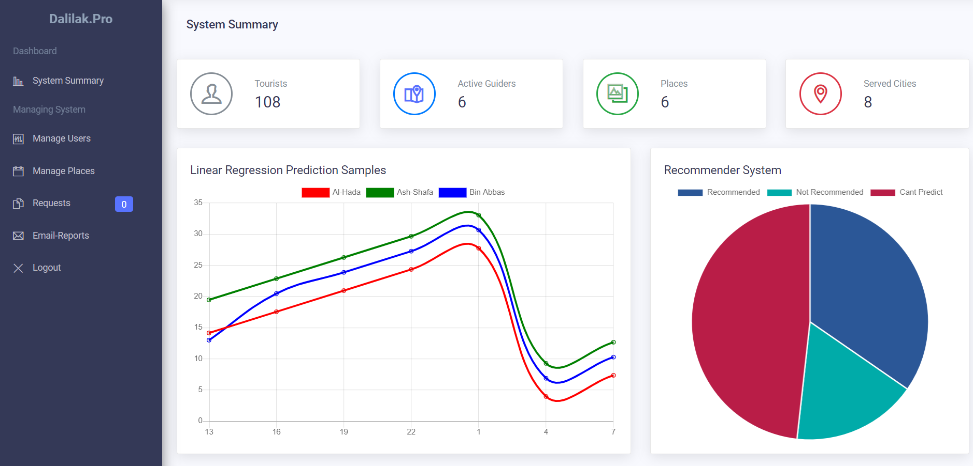
Website - GUI

Slide 19
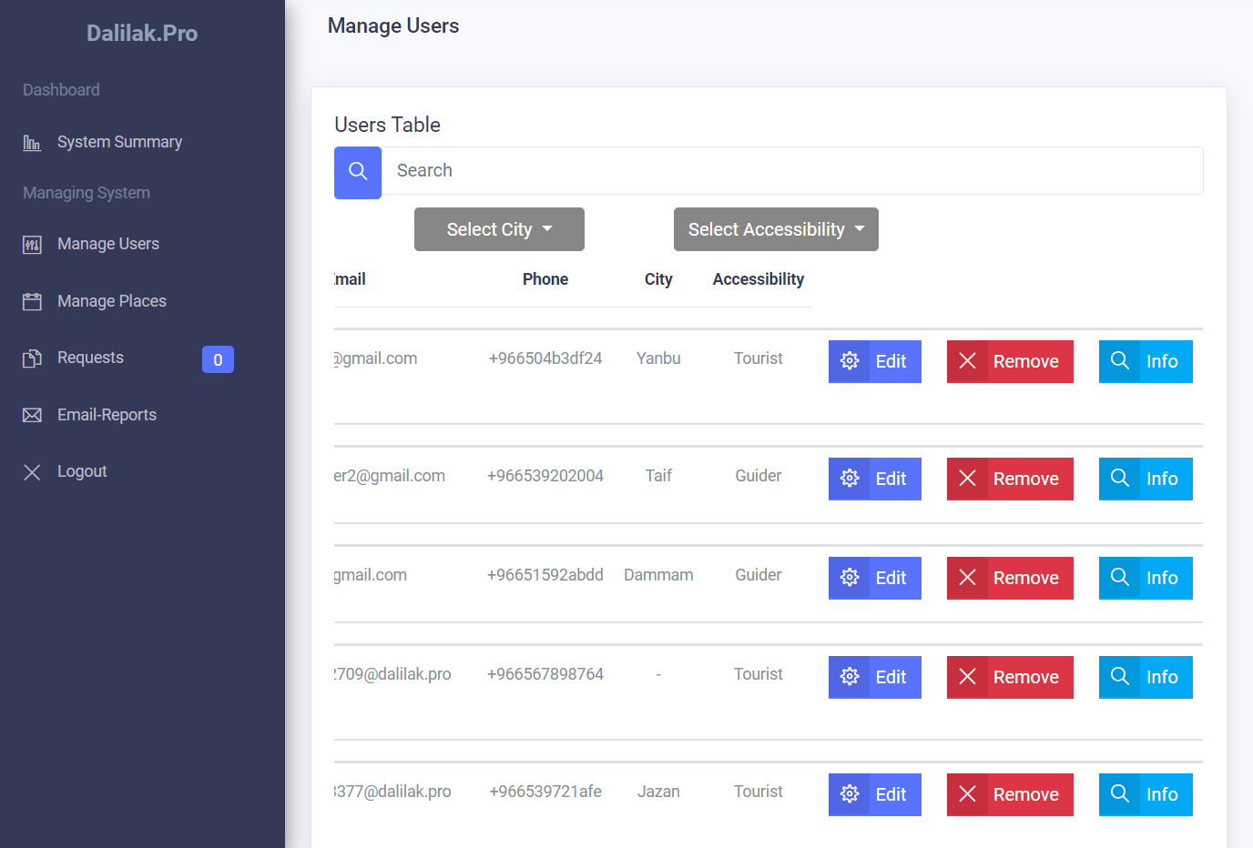
Website - GUI

Slide 20
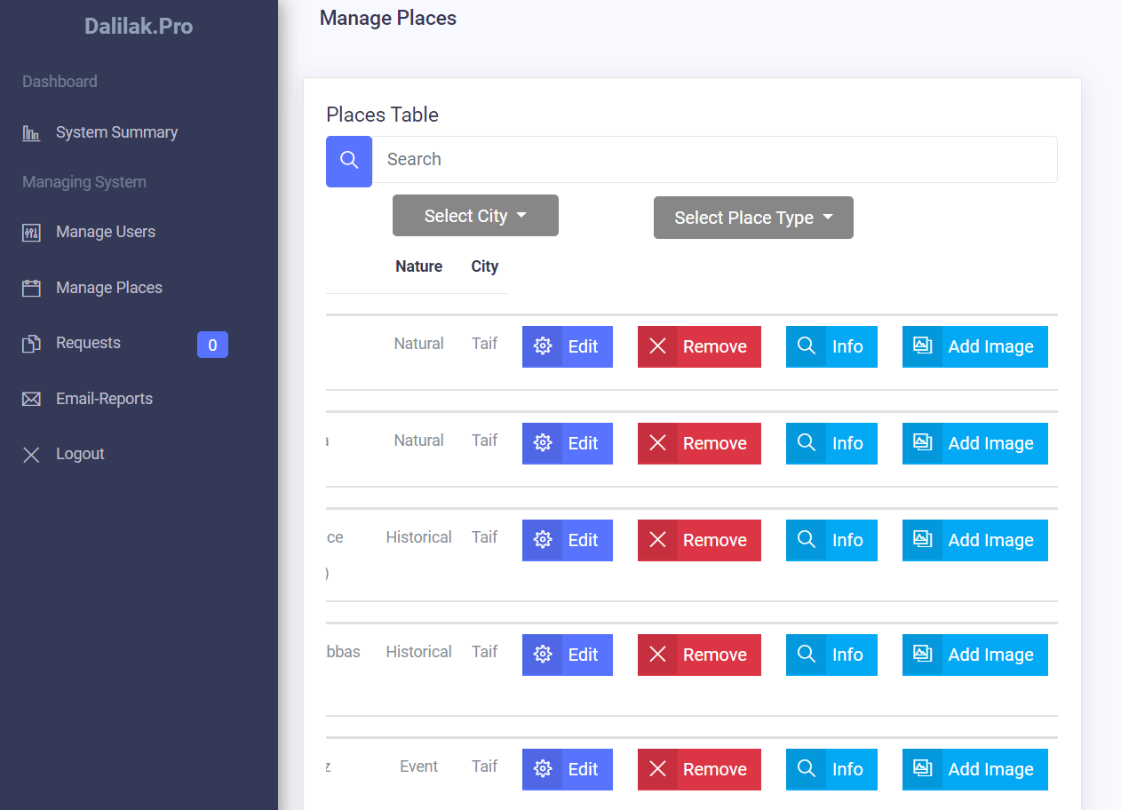
Website - GUI

Slide 21
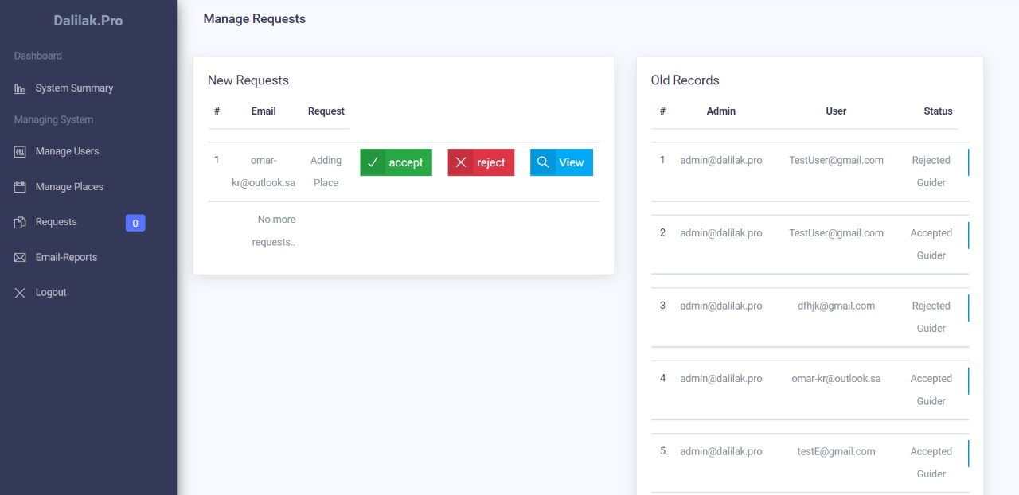
Website - GUI

Slide 22
Test and Evaluation
Scheduling (Manage trips)
precondition | Test case | Test steps | Test data | Expected results | Actual results | Pass/fail
1. user must be logged in 2. click on schedule icon | 1. Manual adding | 1. Press Add icon 2. press manual adding | Select: 1. Place 2. Date 3. Time Then click on add button | Update Current Schedule | Current schedule updated | Pass
 | 2. Auto-adding | 1. Press Add icon 2. press Auto adding | Select: 1. trip start date 2. trip end date 3. time period Then click on Generate button | Generate new Schedule for each different data | New schedules generated | Pass
 | 3. Query Schedule | From schedules list, click on View icon | - | View details of selected schedule | Navigate to another page contains of schedule details | Pass

Slide 23
Test and Evaluation
Manage Requests
precondition | Test case | Test steps | Test data | Expected results | Actual results | Pass/fail
The user shouldn’t be a guider | 1. Request Guidance | 1. Navigate to profile page in mobile application 2. click on Add a new application (CV) to be a guider | Sample of PDF File (CV) | Notify the admin, there is tourist ask to be guider | Admin notified on the website and the request Added to requests list | Pass
The user should be a guider | 2. Add information by guider | 1. Navigate to profile page in mobile application 2. click on Add a new application to add new place | Place name: Test Information: Test Place type: Event Image sample (.png) | Notify the admin, there is guider request to add new place | Admin notified on the website and the request Added to requests list. | Pass
Guiders must send requests in order to make admin review their requests | 3. Accept Guidance request | Navigate to manage requests page on website | Click on accept guider | Refresh old requests list and mark the current transaction by ‘Accepted guider’ | The history of requests has been refreshed, and Total number of guiders in main page increased. | Pass
 | 4. Accept Adding request |  | Click on accept adding | Refresh old requests list and mark the current transaction by ‘Accepted Adding’ | New place has been added, and requests list refreshed. | Pass
 | 5. Reject guidance request |  | Click on Reject Guidance | Refresh old requests list and mark the current transaction by ‘Rejected guider’ | The history of requests has been refreshed, and Total number of guiders in main page remain same. | Pass
 | 6. Reject Adding request |  | Click on Reject adding | Refresh old requests list and mark the current transaction by ‘Rejected Adding’ | No place has been added, and requests list refreshed. | Pass

Slide 24
Future Work
Replace Relational SQL with NoSQL
Detect user location.
Chat rooms between tourists and guiders.
Chat bot
The ability of the system to learn from guiders.
Scale Domains of the system
e-commercial dashboard

Slide 25
Demo

